Slide 1

Introduction to Hadoop Distributed file System and MapReduce Programming

Slide 2
Hadoop was created by Doug Cutting and Mike Cafarella in 2005.
It was originally developed to support distribution for the Nutch search engine project.
Doug, who was working at Yahoo! at the time and is now Chief Architect of Cloudera, named the project after his son's toy elephant.
Cutting's son was 2 years old at the time and just beginning to talk. He called his beloved stuffed yellow elephant "Hadoop"

Slide 3
WHAT IS HADOOP?
At Google MapReduce operation are run on a special file system called Google File System (GFS) that is highly optimized for this purpose.
GFS is not open source.
Doug Cutting and Yahoo! reverse engineered the GFS and called it Hadoop Distributed File System (HDFS).
The software framework that supports HDFS, MapReduce and other related entities is called the project Hadoop or simply Hadoop.
This is open source and distributed by Apache.
Hadoop is a framework to handle the big data efficiently

Slide 4



Slide 5
Hadoop can provide fast and reliable analysis of both structured data and unstructured data.
Two main components in hadoop
Hadoop Distributed File System (HDFS): Hadoop distributed file system (HDFS) is a distributed file system that runs on standard hardware based system. which stores a large amount of data placed across multiple machines.
Hadoop MapReduce: Map-Reduce is a programming model for efficient distributed computing

Slide 6
Hadoop Distributed File System
The Hadoop Distributed File System (HDFS) is the primary data storage system used by Hadoop applications.
It employs a Name Node and Data Node architecture ( Master and Slave ) to implement a distributed file system that provides high-performance access to data across highly scalable Hadoop clusters.
HDFS is a key part of the many Hadoop ecosystem technologies, as it provides a reliable means for managing pools of big data and supporting related big data analytics applications.

Slide 7
How HDFS works
HDFS supports the rapid transfer of data between compute nodes. At its outset, it was closely coupled with MapReduce, a programmatic framework for data processing.
When HDFS takes in data, it breaks the information down into separate blocks and distributes them to different nodes in a cluster, thus enabling highly efficient parallel processing.
Moreover, the Hadoop Distributed File System is specially designed to be highly fault-tolerant.

Slide 8
How HDFS works
The file system replicates, or copies, each piece of data multiple times and distributes the copies to individual nodes, placing at least one copy on a different server rack than the others.
As a result, the data on nodes that crash can be found elsewhere within a cluster. This ensures that processing can continue while data is recovered.

Slide 9
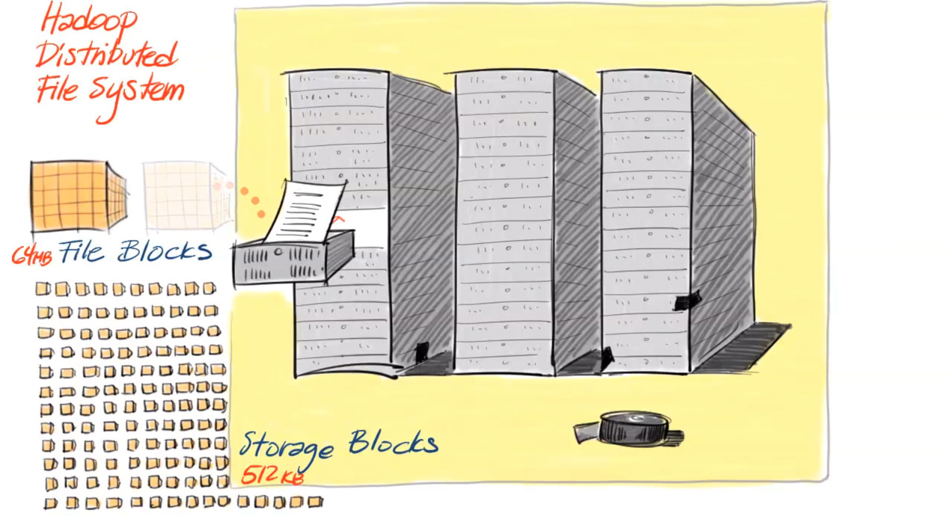

Slide 10
Features: HDFS
Highly fault-tolerant
High throughput
Suitable for applications with large data sets
Streaming access to file system data

Slide 11
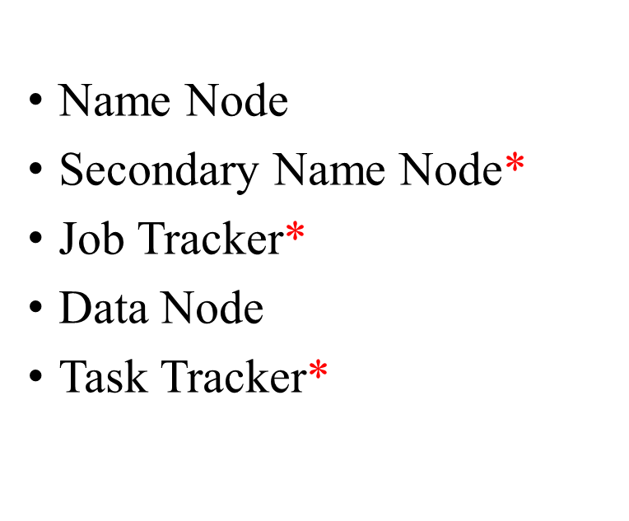
Daemons in Hadoop Core

Slide 12
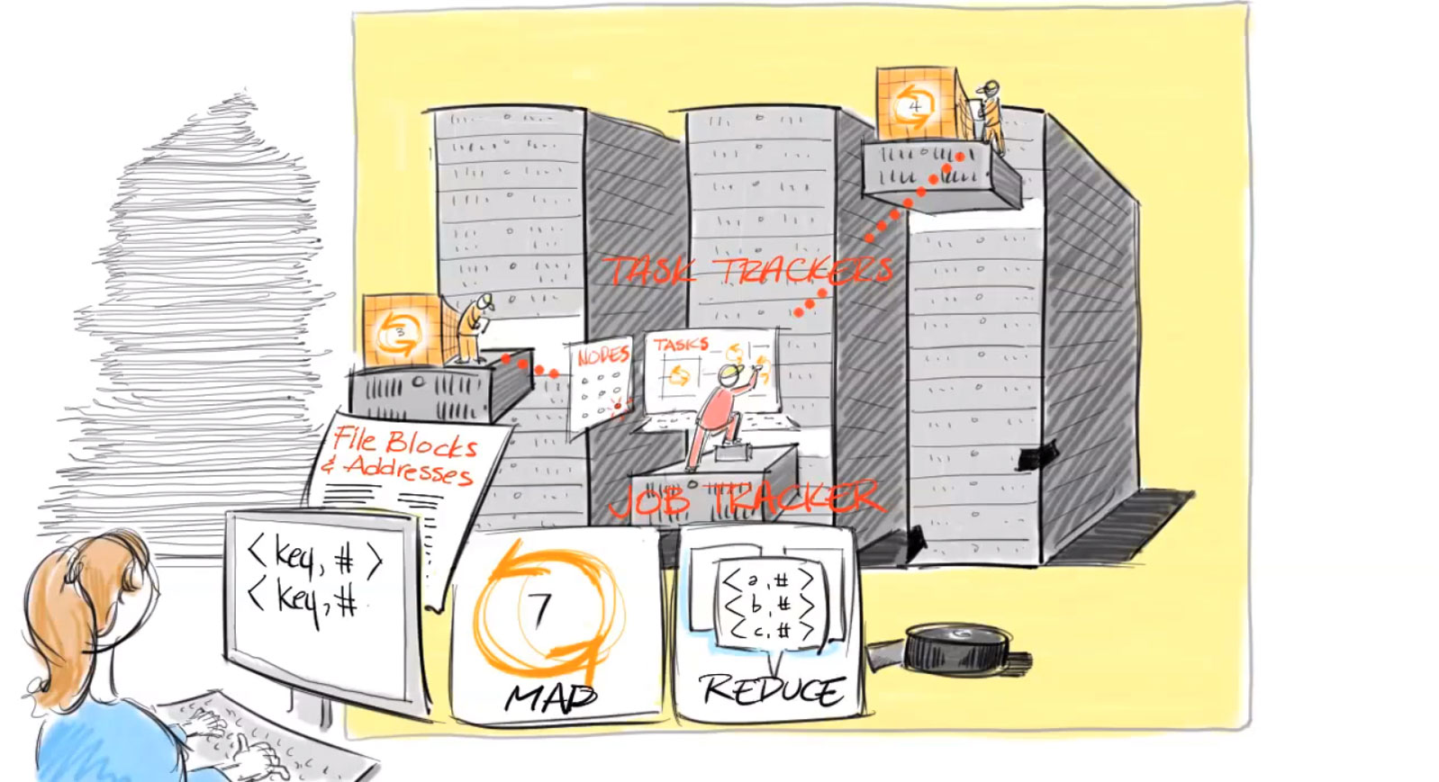

Slide 13
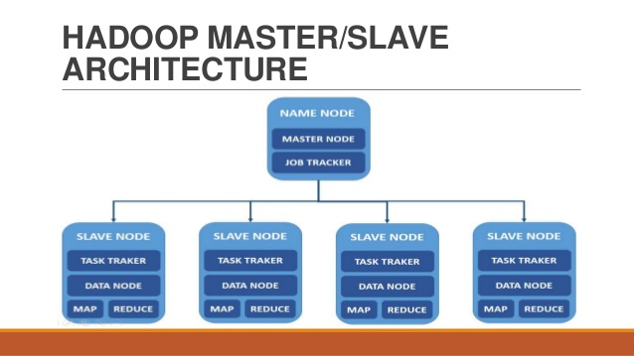

Slide 14
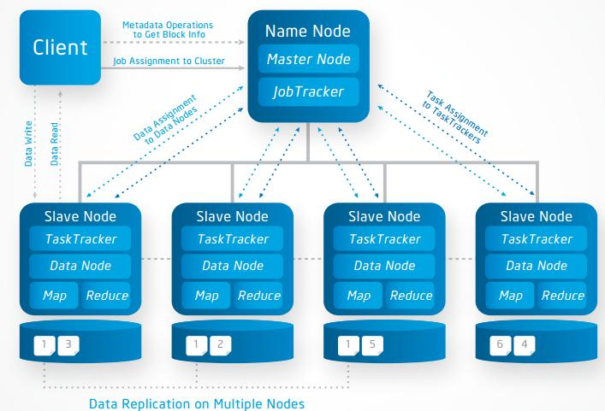

Slide 15
HDFS Files
User data divided into 64MB blocks and replicated across local disks of cluster node to address:
Master/Slave Architecture
  Master (Name node) maintains a name space and metadata
  Slaves (Data nodes): maintain three copies of each data block

Slide 16
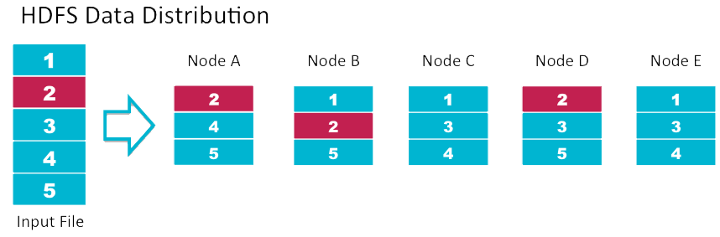
Data Replication
Default replication is 3-fold

Slide 17
Name Node
Name Node, a master server that manages the file system namespace and regulates access to files by clients. ...
The Name Node executes file system namespace operations like opening, closing, and renaming files and directories
Determines mapping of blocks to Data nodes

Slide 18
Job Tracker
The Job Tracker is the service with in Hadoop that farms out MapReduce tasks to specific nodes in the cluster.
Client applications submit jobs to the Job tracker.
The Job Tracker submits the work to the chosen Task Tracker nodes.

Slide 19
Secondary Name Node
Secondary Name Node in hadoop is a specially dedicated node in HDFS cluster
whose main function is to take checkpoints of the file system metadata present on name node.
It is not a backup name node.
It just checkpoints name node's file system namespace.

Slide 20
Data Nodes
A Data Node stores data in the [Hadoop Distributed File System].
This functional file system has more than one Data Node, with data replicated across them.
On startup, a Data Node connects to the Name Node; spinning until that service comes up.
It then responds to requests from the Name Node for file system

Slide 21
Task Tracker
A Task Tracker is a node in the cluster that accepts tasks - Map, Reduce process from a Job Tracker.
Every Task Tracker is configured with a set of slots, these indicate the number of tasks that it can accept.

Slide 22
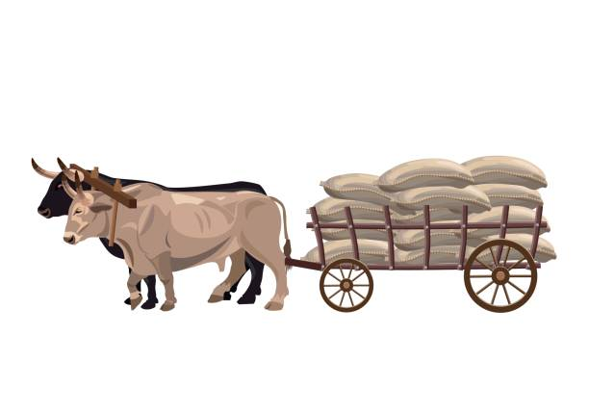
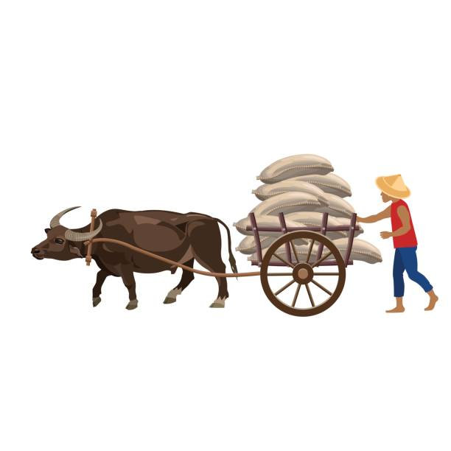
Capacity of the first bull is 200 kg but
But it is loading 500
In second images the load is distributed to 2 bull so it is easy to carry

Slide 23
MapReduce Processing

Slide 24
MapReduce is a framework for processing large datasets using a large number of computers (nodes), collectively referred to as a cluster
Processing can occur on data stored in a file system (HDFS)
A method for distributing computation across multiple nodes
Each node processes the data that is stored at that node
Consists of two main phases
  Mapper Phase
  Reduce phase

Slide 25
Simple view of Map Reduce
Map
I/P File
Reduce
HDFS
Map

Slide 26
MAPPER FLOW
Input data set is split into independent blocks – processed in parallel.
Each input split is converted in Key Value pairs.
Mapper logic processes each key value pair and produces and intermediate key value pairs based on the implementation logic.
Resultant key value pairs can be of different type from that of input key value pairs.
The output of Mapper is passed to the reducer.

Slide 27
REDUCER FLOW
Output of Mapper function is the input for Reducer
Reducer sorts the intermediate key value pairs
Applies reducer logic upon the key value pairs and produces the output in desired format
Output is stored in HDFS

Slide 28
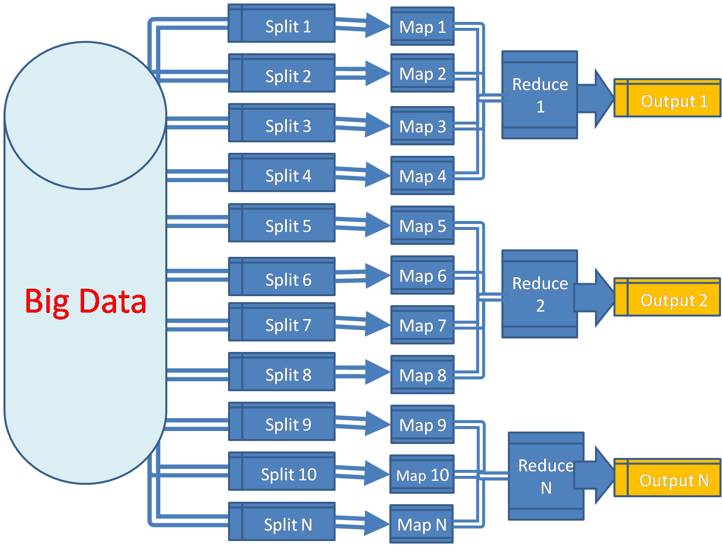

Slide 29
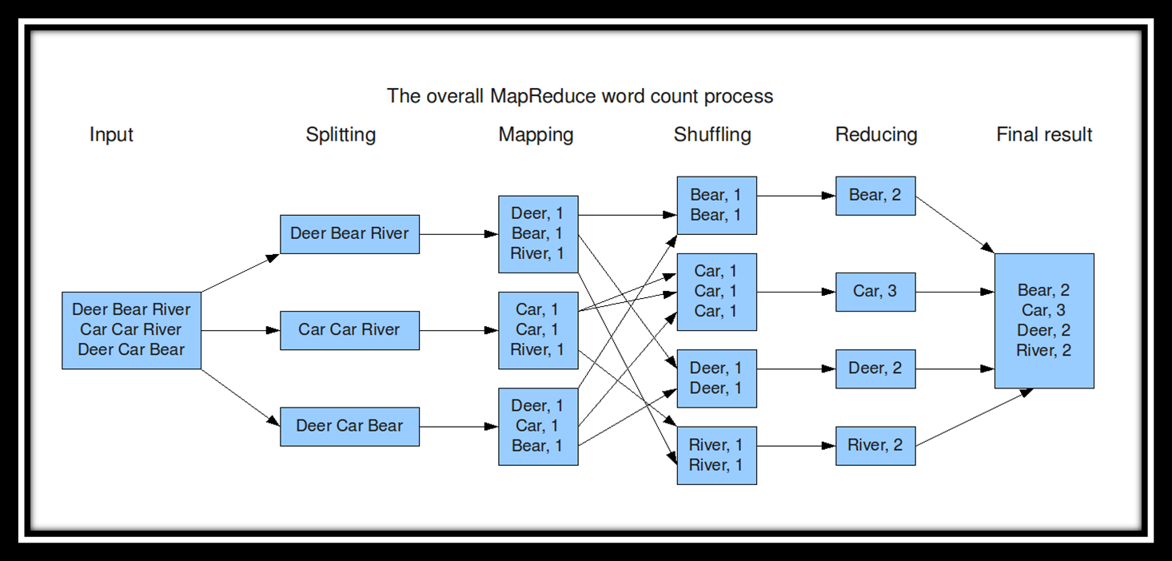
MapReduce: Word Count

Slide 30
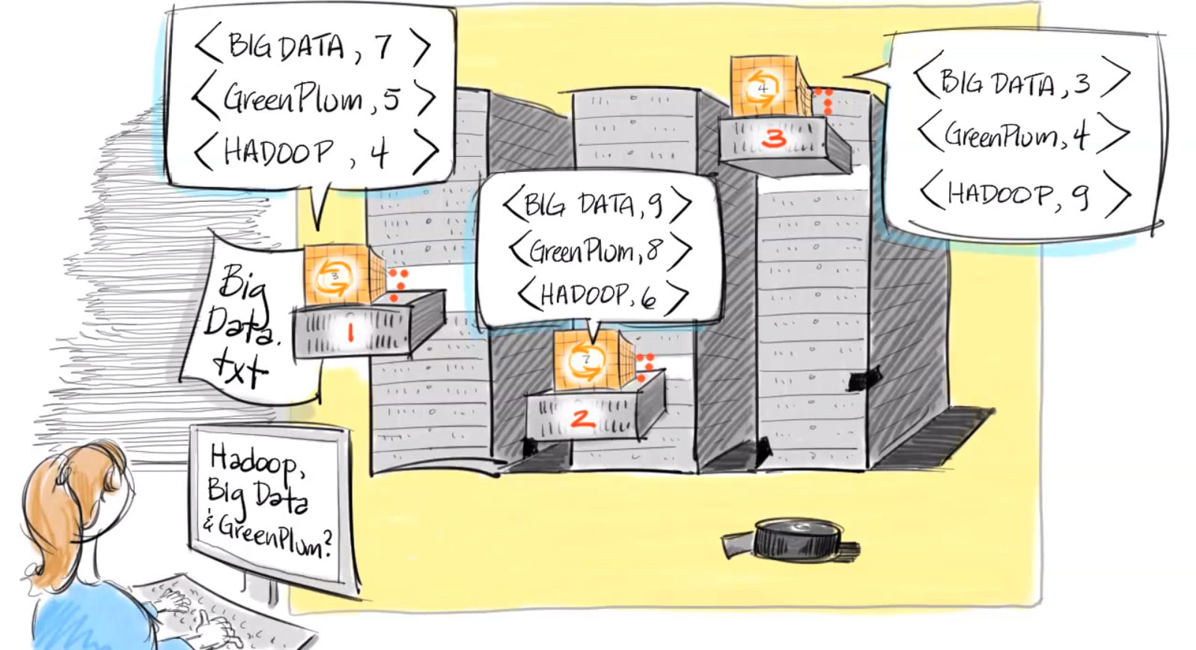

Slide 31
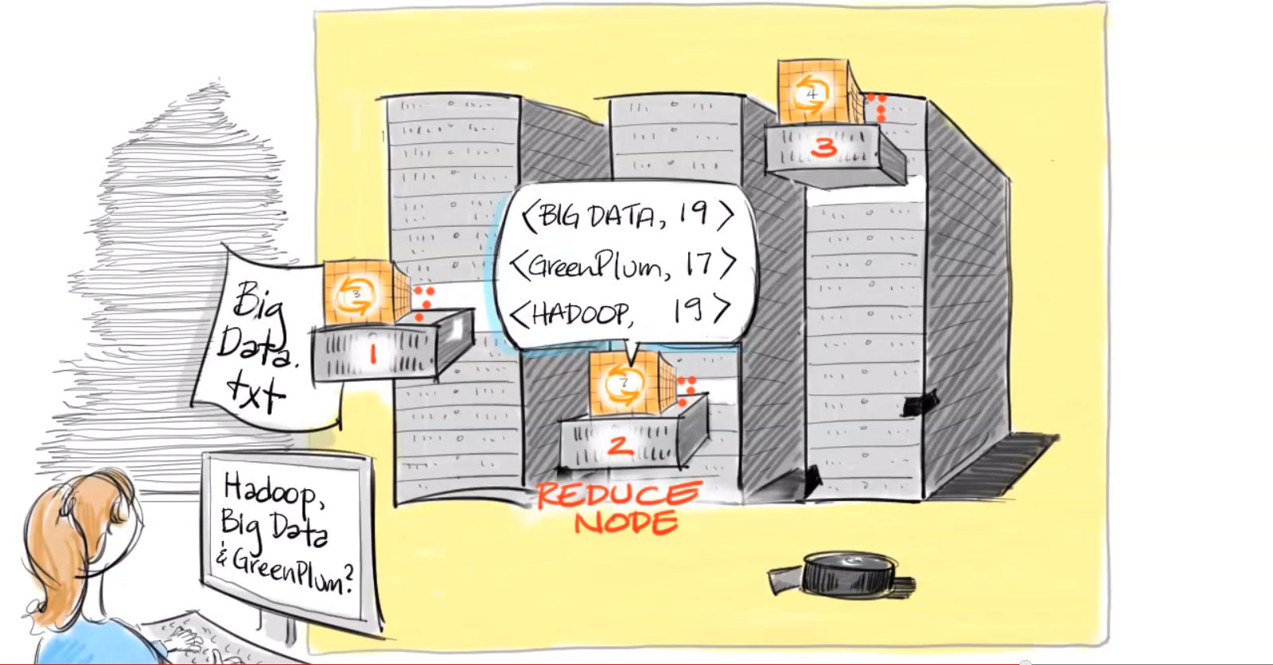

Slide 32
Motivation Questions
Problem 1: Data is too big to store on one machine.
HDFS: Store the data on multiple machines

Slide 33
Motivation Questions
Problem 2: Very high end machines are too expensive
HDFS: Run on commodity hardware

Slide 34
Motivation Questions
Problem 3: Commodity hardware will fail!
HDFS: Software is intelligent enough to handle hardware failure
Notes:
1%-10%-100%

Slide 35
Motivation Questions
Problem 4: What happens to the data if the machine stores the data fails?
HDFS: Replicate the data

Slide 36
Motivation Questions
Problem 5: How can distributed machines organize the data in a coordinated way?
HDFS: Master-Slave Architecture

Slide 37


